Slide 1
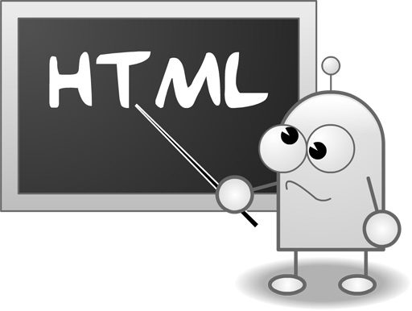
Presentation
Group 2

Slide 2
I - Introduction
What is HTML?
→ Hyper Text Markup Language
→ A markup language is a set of markup tags
→ HTML documents are described by HTML tags
→ Each HTML tag describes different document content
Ex:
<h1>My First Heading</h1> → describes a heading
<p>My first paragraph.</p> → describes paragraph
Notes:
Ngôn ngữ đánh dấu có cả văn bản và thông tin phụ về văn bản. Thông tin này, thí dụ nói về cấu trúc của tập tin hay cách trình bày văn bản, là mã đánh dấu được pha trộn vào văn bản chính.

Slide 3

HTML Tag
start tag
end tag
HTML tags normally come in pairs
The end tag is written like the start tag, but with a slash before the tag name
Ex: <h1> My First Heading </h1>
Content

Slide 4
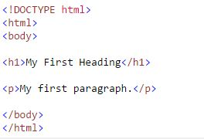
HTML Page Structure
→ HTML elements can be nested (elements can contain elements).
Notes:
The DOCTYPE declaration defines the document type
The text between <html> and </html> describes the web document
The text between <body> and </body> describes the visible page content
→ can we omit html or body tag????

Slide 5

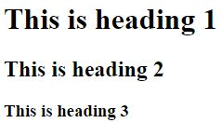
Pre-Demo
1. HTML Headings

Slide 6


Pre-Demo
2. HTML Paragraphs

Slide 7
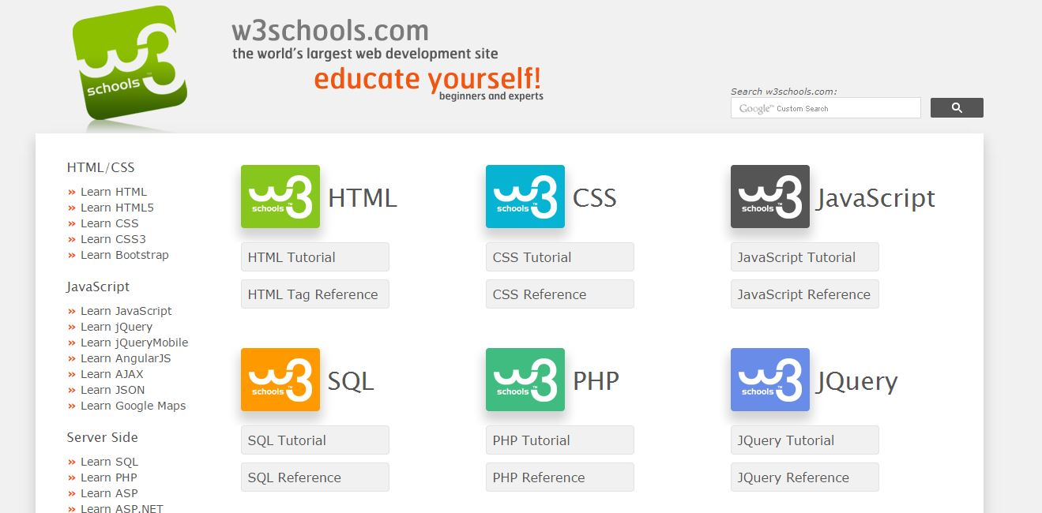
Pre-Demo
3. HTML Links
HTML elements can have attributes
Attributes provide additional information about an
element
Attributes are always specified in the start tag
Notes:
Attributes come in name/value pairs like: name="value"

Slide 8
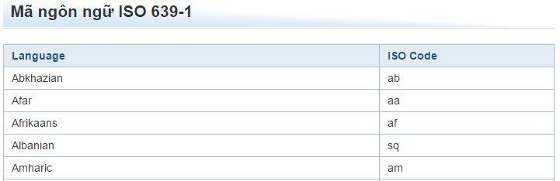
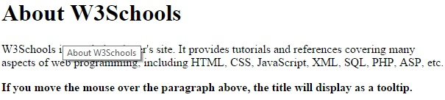
>> HTML Attribute
<html lang="en-US"> declares the language
<p title="About W3Schools">

Slide 9
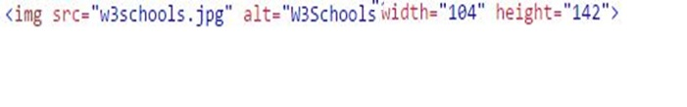
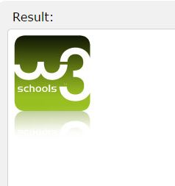
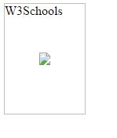
Pre-Demo
4. HTML Images

Slide 10
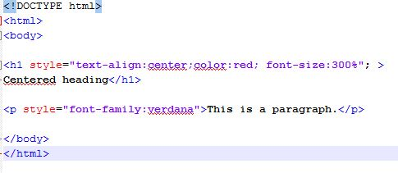
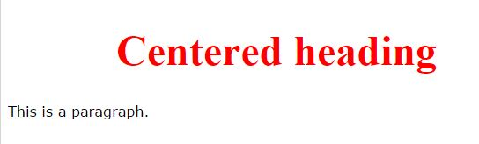
Pre-Demo
5. HTML Styling

Slide 11




Pre-Demo
6. HTML List
6.1 Unordered List

Slide 12
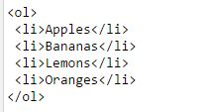

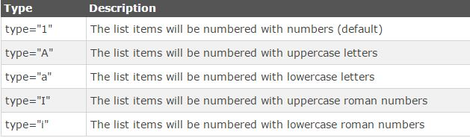
6.2 Ordered List

Slide 13
Pre-Demo
7. HTML Block Elements
<div>
→ is a block level element
→ can be used as a container for other HTML elements
→ has no required attributes, but style and class are common.
<span>
→ is an inline element that can be used as a container for text
→ has no required attributes, but style and class are common.

Slide 14

Pre-Demo
8. HTML Form & Input
<form>
→ is used create HTML form
to pass data to a server.
→ can contain input elements
and more.
<input>
→ is the most important form element.
→ is used to select user information.

Slide 15




Pre-Demo
8. HTML Form & Input (some Input types)
<input type="text">
<input type="submit">

Slide 16

Pre-Demo
9. HTML5 Video
→ The HTML5 <video> element specifies a standard way to embed a video in a web page.
Text between the <video> and </video> tags will only display in browsers that do not support the <video> element.
Notes:
Before HTML5, there was no standard for showing videos on a web page.
Before HTML5, videos could only be played with a plug-in (like flash).
***Replace “control” with “autoplay”.

Slide 17
More about HTML & HTML5:
http://www.w3schools.com/html/
Thanks for listening.

